Slide 1


J-J-J-JEA!

Slide 2
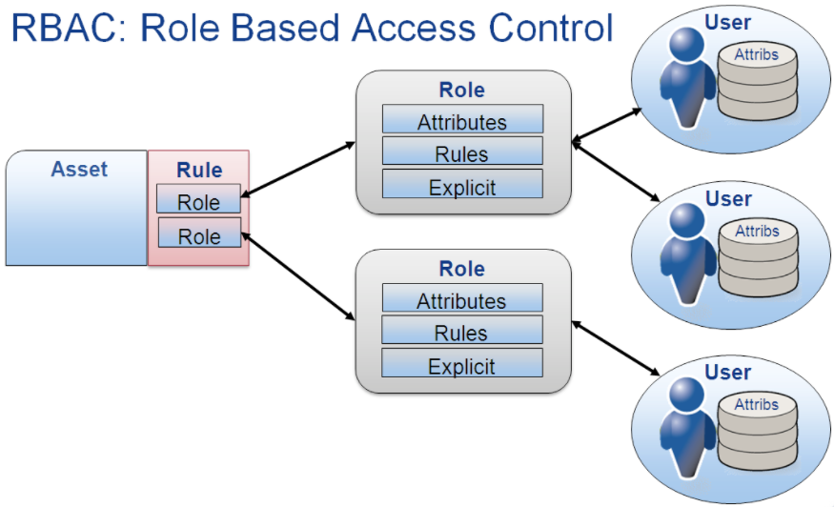
What is JEA?
An Acronym for: Just Enough Administration
Simple Answer
It’s RBAC for PowerShell
Allows RBAC rules & roles
to be applied to PowerShell

Slide 3



Constrained PowerShell Endpoint
Available Cmdlets are limited
Cmdlets
Cmdlet parameters
Cmdlet parameter values
Language Mode
By default, JEA session run in “No Language” mode
Severely limits what scripts can do
Restricted Access
Only specific users or groups can connect
Can specify that users must also belong to additional groups
JIT / Just In Time administrative restrictions

Slide 4

Why JEA?
Reduce the number of Administrators
The JEA service account executes commands on users’ behalf so you don’t need to assign administrative rights to users.
Limit users abilities
Restrict the cmdlets, functions and external commands that can be run
Better understand what users are doing
Transcripts and logs show which user executed what command
Why is this important?
Highly privileged user accounts pose a security risk
Admin permissions for one task often include additional
permissions which are unnecessary and can be dangerous
if an account is compromised

Slide 5
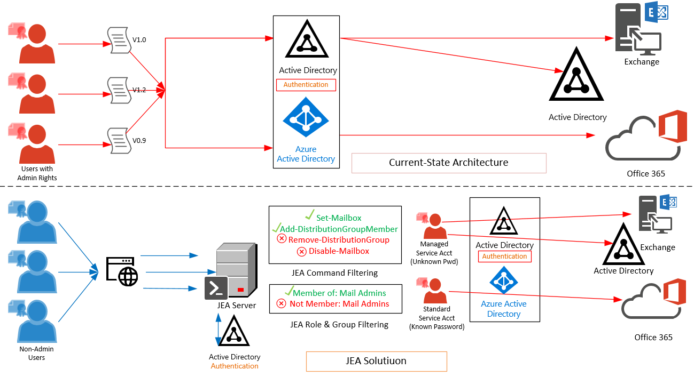

Slide 6

Deploying JEA: Prerequisites
Supported on Windows server and workstation platforms
Windows 7 and up, Windows Server 2008 R2 and up,
Windows Server 2012 and up recommended
Windows 7 and 2008 R2 do not support Group Managed Service Accounts so their JEA functionality is limited
Windows Management Framework 5.1
Powershell 5 is supported, but Powershell 5.1 is recommended
Enable Powershell Remoting
Enable-PSRemoting
Enable Powershell Module and Script Block Logging (optional)
Group Policy: Computer Configuration\Administrative Templates\Windows Components\Windows PowerShell

Slide 7
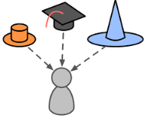
Deploying JEA: Role Capabilities
Each role that you define requires a separate role capabilities file
Create a new (empty) module on the computer and place the role capabilities file in a subfolder of the module directory
Can be updated “on-the-fly”, new sessions will get the new settings immediately
New-PSRoleCapabilityFile -Path .\MyModule\RoleCapabilities\MyFirstJEARole.psrc

Slide 8
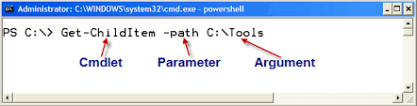
Deploying JEA: Role Capabilities
Define cmdlets, parameters and value sets
VisibleCmdlets = @{ Name = 'Restart-Service';Parameters = @{ Name = 'Name'; ValidateSet = 'Dns', 'Spooler' }}
Can also use: ValidatePattern = '*gmail.com'
Functions can be allowed using the same syntax
VisibleCmdlets = @{Name='My-Function'}
PowerShell common parameters are always allowed.
Wildcards can be used, but this is not recommended.

Slide 9

Deploying JEA: Role Capabilities
External Commands
WhoAmI.exe, MyCustomScript.ps1
VisibleExternalCommands = 'C:\Windows\System32\whoami.exe', 'C:\Program Files\Contoso\Scripts\UpdateITSoftware.ps1'
Always use PowerShell cmdlet equivalents of external commands wherever possible
Get-SmbShare instead of Net.exe

Slide 10



Deploying JEA: Role Capabilities
Providers
By default, no providers are available in JEA sessions
VisibleProviders = 'Registry', 'FileSystem'
Use Get-PSProvider to see the providers available on your system

Slide 11

Deploying JEA: Session Configuration
New-PSSessionConfigurationFile -SessionType RestrictedRemoteServer -Path .\MyJEAEndpoint.pssc
RestrictedRemoteServer type configures the session to operate in NoLanguage mode
NoLanguage = No variables, no operators (-gt, -le, -or, -and), no methods (.ToString())
See link in final slide for more details.
Configures overall session parameters
Some functionality overlap with role files (Visible providers)

Slide 12

Session Configuration: Service Account
Service accounts
All allowed commands are executed on a user's behalf by a Service Account
Local virtual account (local machine only)
This is a temporary account that exists only for the duration of the session
By default, this account has local Administrator rights, or Domain Admin if the server is a Domain Controller
If one or more local groups are specified, the account will belong only to those groups and not local/domain admin.
RunAsVirtualAccount = $true
RunAsVirtualAccountGroups = 'NetworkOperator', 'NetworkAuditor'

Slide 13

Session Configuration: Service Account
Group Managed Service Account (domain)
When you require access to network resources, other computers or web services
GroupManagedServiceAccount = 'Domain\MyJEAgMSA'
Password for a GMSA is managed by the domain and unknown to users or administrators.
Rights for the GMSA must be configured on the resource itself, not in JEA
Only use GMSA when necessary
Can be difficult to trace back to the user who executed the command (must use logs)
Account may have access to more resources than needed by the user

Slide 14

Session Configuration: Roles
Role Definitions
Defines what users/groups are assigned the roles defined in the role capability files.
More than one role can be assigned
Roles are additive
RoleDefinitions = @{
'CONTOSO\JEA_DNS_ADMINS' = @{ RoleCapabilities = 'DnsAdmin', 'DnsOperator', 'DnsAuditor' }
'CONTOSO\JEA_DNS_OPERATORS' = @{ RoleCapabilities = 'DnsOperator', 'DnsAuditor' }
'MyComputer\JEA_Local_DNS_AUDITORS' = @{ RoleCapabilities = 'DnsAuditor' }}
Always use the ComputerName\ syntax when specifying a local user or group (not localhost or other aliases)

Slide 15


Session Configuration: Conditional Access
Require additional/conditional group membership(s)
Requires PowerShell 5.1
Use cases: 2-factor authentication, Just In Time access (JIT), Etc.
Examples
# Example 1: Connecting users must belong to a security group called "elevated-jea"
RequiredGroups = @{ And = 'elevated-jea' }
# Example 2: Connecting users must have signed on with 2 factor authentication or a smart card. The 2 factor authentication group name is "2FA-logon" and the smart card group name is "smartcard-logon"
RequiredGroups = @{ Or = '2FA-logon', 'smartcard-logon' }
# Example 3: Connecting users must elevate into "elevated-jea" with their JIT system and have logged on with 2FA or a smart card
RequiredGroups = @{ And = 'elevated-jea', @{ Or = '2FA-logon', 'smartcard-logon' }}

Slide 16
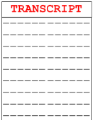


Session Configuration: Misc
Transcript Configuration
TranscriptDirectory = 'C:\ProgramData\JEAConfiguration\Transcripts'
User Directory
Configurable per-user space for a working directory without exposing the server’s full file system or the FileSystem provider. Requires PowerShell 5.1.
MountUserDrive = $true
UserDriveMaximumSize = 524288000
Session configuration changes require you to re-register the JEA configuration to take effect

Slide 17

Registering JEA
You must register your Session Configuration before users can access JEA
Register-PSSessionConfiguration -Path .\MyJEAConfig.pssc -Name 'JEAMaintenance' -Force
JEA can also be configured and registered using DSC
Helpful when configuring multiple JEA endpoints
Remove the JEA configuration by unregistering
Unregister-PSSessionConfiguration -Name 'ContosoMaintenance' -Force
Registering/Unregistering JEA will restart the WinRM service and disconnect all sessions

Slide 18


Using JEA
Users connect using standard PowerShell remote session
Enter-PSSession -ComputerName localhost -ConfigurationName JEAMaintenance -Credential $nonAdminCred
New-PSSession
Import-PSSession
Invoke-Command
Logs/Transcripts
Microsoft-Windows-PowerShell/Operational ; EventID 4104
Shows command run, connected user and RunAs user
Other application logs will only show changes being made by the RunAs user
Transcript directory is specified in the session configuration
Also shows connected user and RunAs user as well as all console output

Slide 19
More Information
Overview
https://docs.microsoft.com/en-us/powershell/jea/overview
JEA Helper Tool – GUI to help build Role and Session files
https://gallery.technet.microsoft.com/JEA-Helper-Tool-20-6f9c49dd
JEA and JIT presentation from Microsoft Ignite
https://channel9.msdn.com/Events/Ignite/Australia-2017/INF336
No Language Mode
https://docs.microsoft.com/en-us/powershell/module/microsoft.powershell.core/about/about_language_modes?view=powershell-6&viewFallbackFrom=powershell-Microsoft.PowerShell.Core
Group Managed Service Accounts
https://docs.microsoft.com/en-us/windows-server/security/group-managed-service-accounts/group-managed-service-accounts-overview
JEA Security Considerations
https://docs.microsoft.com/en-us/powershell/jea/security-considerations

Slide 20
QUESTIONS?

